Slide 1
Microsoft Excel 2013
Dr. Wameedh. T.M. Al-Tameemi

Slide 2
Excel 2013 Insert list

Slide 3
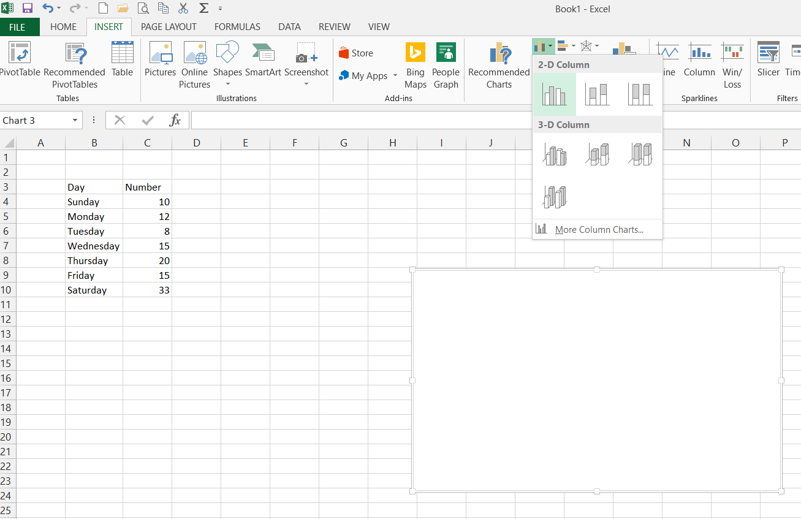
Excel 2013 Insert list
Inserting charts – column chart
Insert → charts → column chart
R click → select data→
Choose Add→

Slide 4
Excel 2013 Insert list
Inserting charts – column chart
Insert → charts → column chart
Select series name, series values→ ok
Use Edit to replace numbers in x-axis by day names

Slide 5
Excel 2013 Insert list
Inserting charts
Insert → charts → Other charts

Slide 6
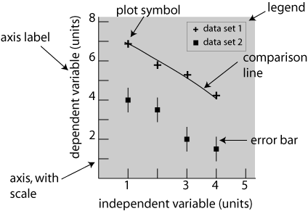
Excel 2013 Insert list
Inserting charts - scatter
Insert → charts → scatter charts

Slide 7
Excel 2013 Insert list
Insert → Charts → Scatter

Slide 8
Excel 2013 Insert list
R-click on the graph area → select data
Choose Add to add data

Slide 9
Excel 2013 Insert list
Choose Series name cell
Choose Series X values
Choose Series y values
Press ok button after choosing the data series

Slide 10
Excel 2013 Insert list
Press ok If you finish, Or Add to add another Series of data similar to the previous one.

Slide 11
Excel 2013 Insert list

Slide 12
Excel 2013 Insert list
R-Click on any data point of the data series in the graph and choose Format data series

Slide 13
Excel 2013 Page layout list

Slide 14
Excel 2013 Next
Next lecture: Formulas
Thank you very much

